Slide 1
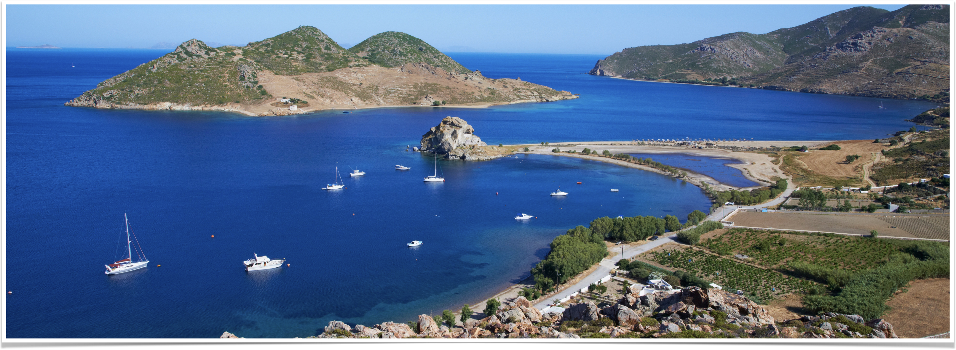
The Revelation of Jesus Christ
Vision 2 , Part 3 (6:1-11) - The First Four Seals

Slide 2
4 nations in Daniel 2 and 7
Neo-Babylonian Empire — carried Judah into captivity
Persia — rebuilt the temple and reconstituted the Israelite homeland
Greece — brought a universal language, culture, philosophy, thought (e.g. Septuagint)
Rome — built the Pax Romana (the peace of Rome); stability allowed for the spread of the gospel

Slide 3
Nations with evil intent
Zechariah1:14-15, “they helped – but with evil intent”
Babylon: Is. 47:5-9: “You showed them no mercy” (verse 6)
The Persians nearly allowed the Jews to be wiped out by Haman (the book of Esther)
Greeks: Antiochus Epiphanies profaned the temple (see Daniel 8:23-27)
Rome: Nero and Domitian persecuted the church

Slide 4
The seals and the trumpets are god’s judgment of the roman empire.

Slide 5
A few passages to remember
1:1, “things which must shortly take place.”
1:19: “Write the things which you have seen (his first vision of the glorified Jesus), and the things which are (the letters to the seven churches), and the things which will take place after this (after this current period in time).”
4:1, “Come up here, and I will show you things which must take place after this.”
Series of visions takes place toward the end of Domitian’s reign (96 AD)

Slide 6
Seal #1: The age of the antonines

Slide 7
Seal #1 - What John sees
“white” - purity and/or victory; in war it must refer to victory
“crown” - Gr. stephanos – a laurel wreath worn by a conquering hero
“bow” - not a weapon of Rome; the use of which was perfected by the Cretans
“went out conquering and to conquer” - uninhibited victory

Slide 8
The age of the Antonines - 96-180 AD
96-98: Nerva (a Cretan)
98-117: Trajan (the greatest conqueror since Julius Caesar)
117-138: Hadrian (the greatest emperor since Caesar Augustus)
138-161: Antoninus Pius (the zenith of the Antonines)
161-180: Marcus Aurelius (the philosopher king)

Slide 9
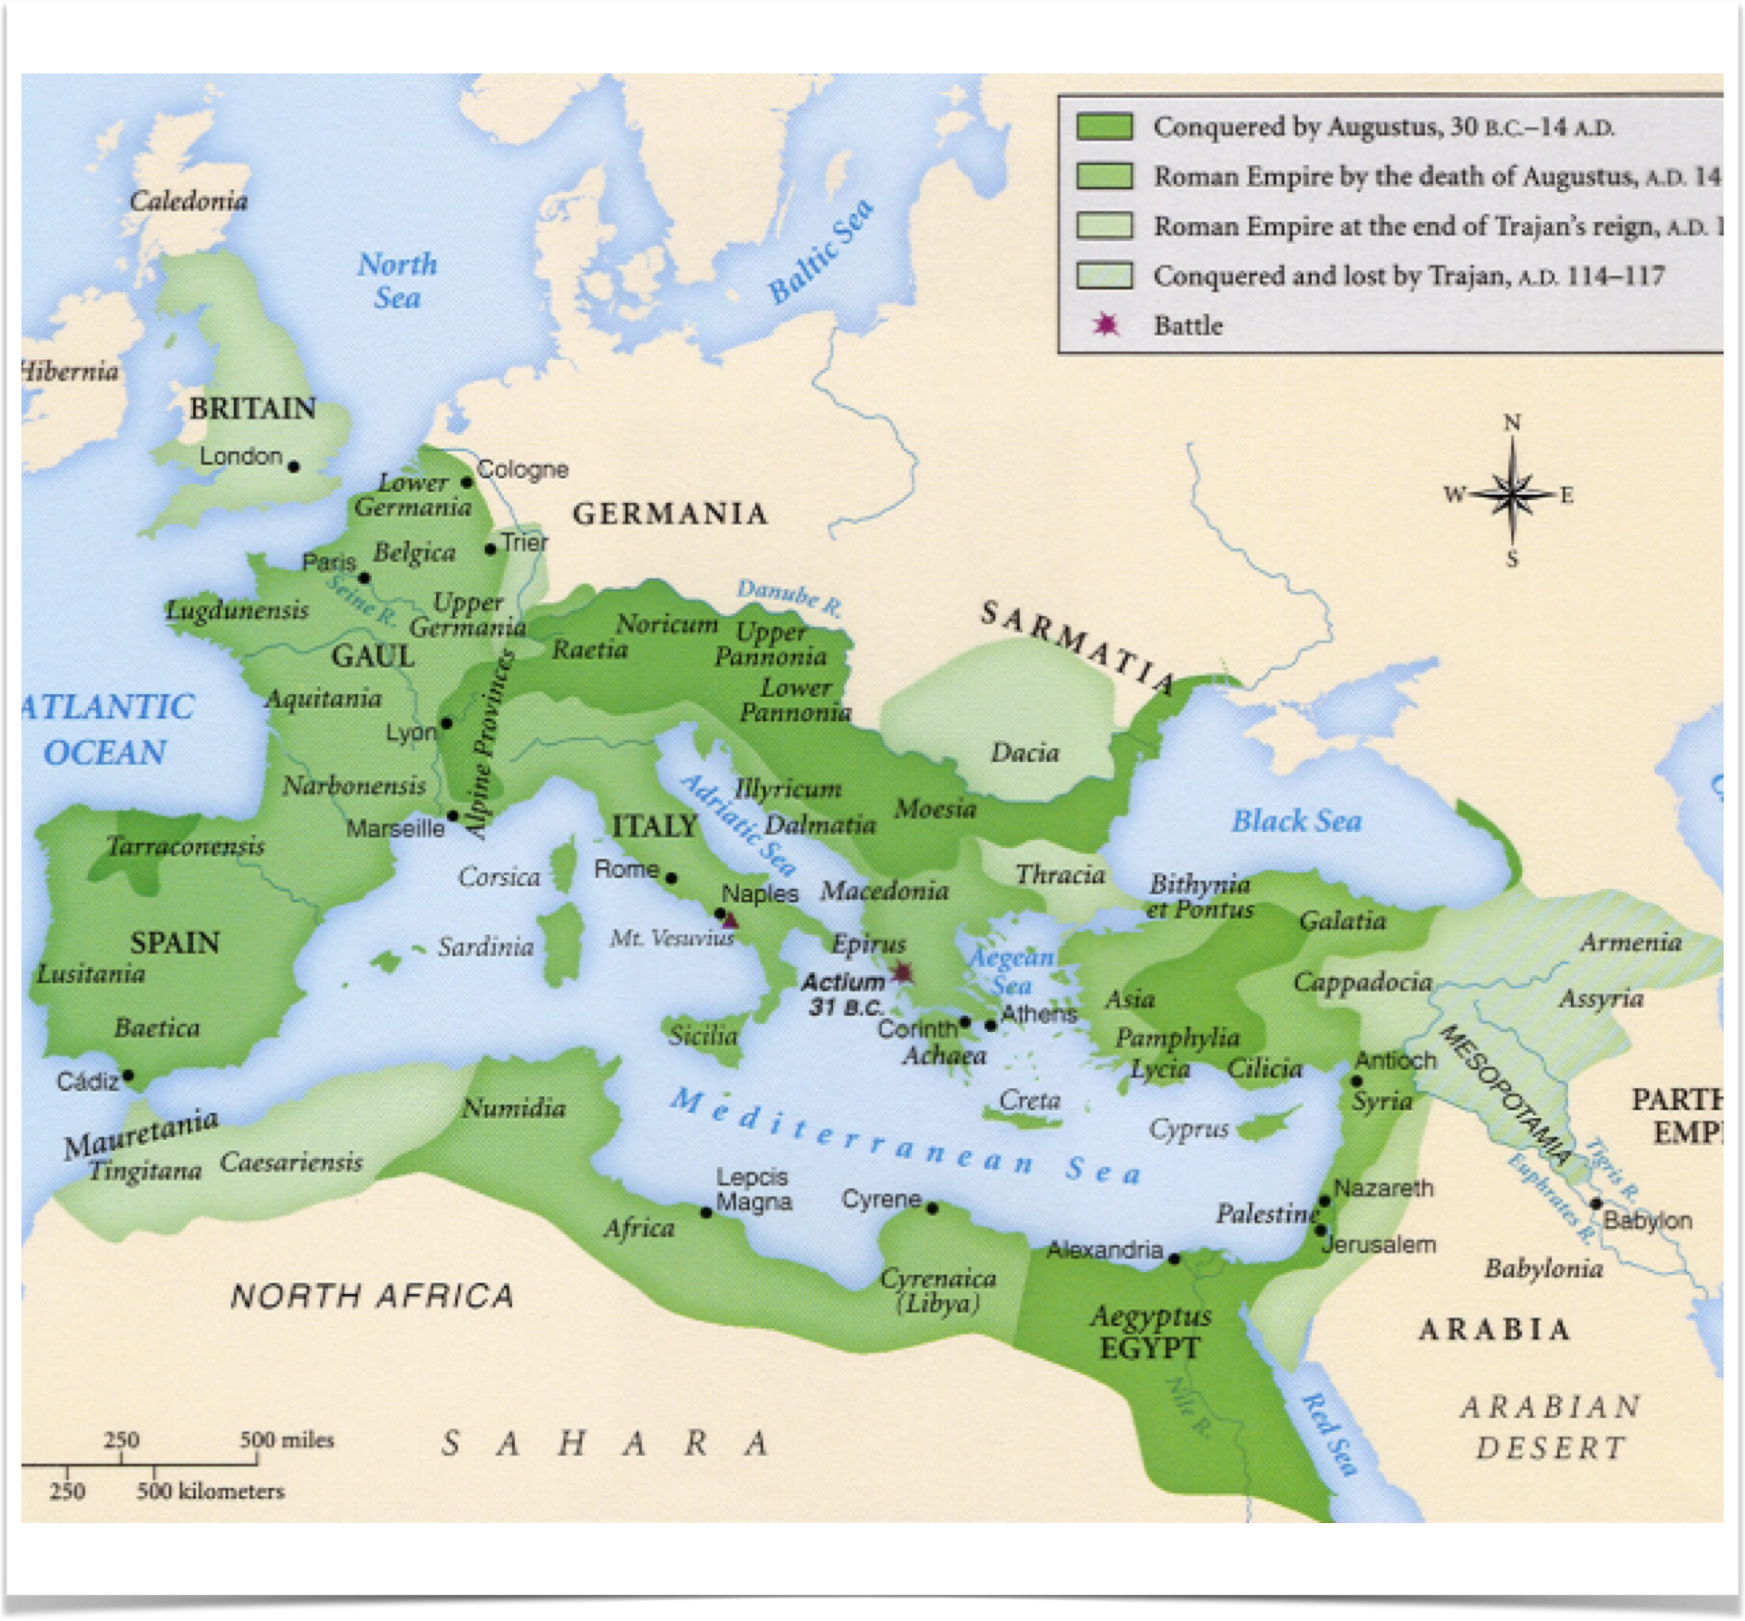
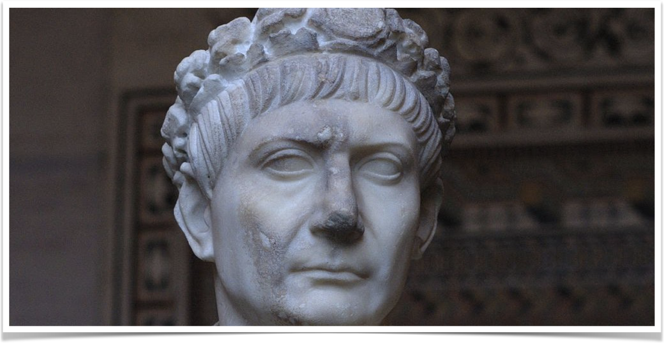
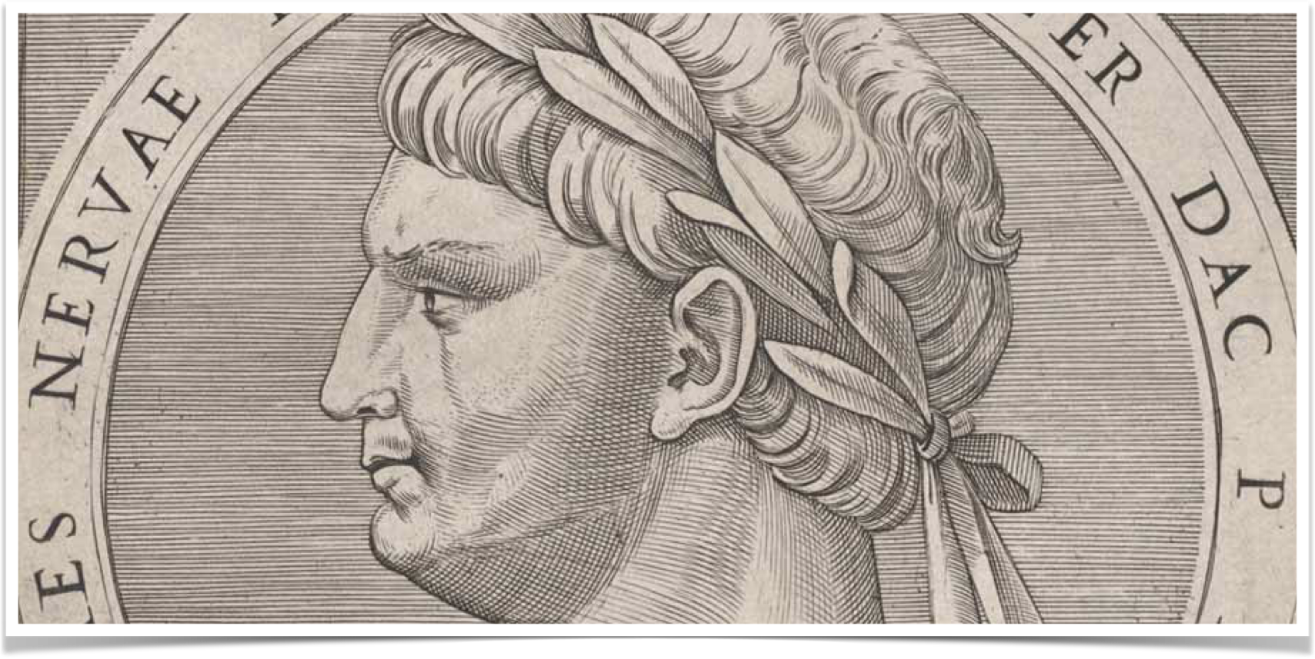
Notes:
Map of the extent of the Roman Empire under Trajan
Top right: Trajan with a “victor’s crown” (stephanos)
Bottom right: coin of Nerva wearing a stephanos

Slide 10
Summary of Seal #1
White horse - victory in war
The crown (Gr. stephanos) - worn by victorious Roman emperors when returning to Rome
Bow - a new line of non-Latin emperors beginning with a Cretan, Nerva
External victory, internal peace, and great prosperity

Slide 11
Seal #2: Civil War

Slide 12
Seal #2 - What John sees
“red” - blood, a bloody war, carnage, excessive bloodshed
“take peace from the earth” - once existed a state of peace
“kill one another” - a period of civil war
“great sword” - standing army
“the earth” - the portion of the earth governed by Rome

Slide 13
A century of chaos - 183-284 AD
193 - Commodus, son of Marcus Aurelius, assassinated
193 - “The Year of Five Emperors”
193-235 - The Severan Dynasty
235-284 - The Crisis of the Third Century
  Maximinus Thrax - 235-238
  From 235-270, thirty seven men were proclaimed emperor of Rome

Slide 14
Summary of Seal #2
Red horse - bloody war
Take peace from the earth - no peace where once there had been peace
Kill one another - civil war
Great sword - standing armies; legions and Praetorian Guard often vying for power
The earth - the portion governed by Rome

Slide 15
Seal #3 - Economic depression and famine

Slide 16
Seal #3 - What John Sees
“black” - calamity as the result of strife
“balances” - weighing bread in order to ration (see Leviticus 26:26)
  The weighing of bread symbolizes scarcity of bread (see Ezekiel 4:16)
  The only rider not wielding an implement of war
“denarius” - a day’s wages
  Indicative of inflation – the denarius' purchasing power was drastically less (see 2 Kings 6:24-25)

Slide 17
Economic downturn - mid 3rd century
Indigenous farmers could not compete with foreign imports
High taxes led to poor profits and declining resources for upkeep
Precious metals depleted, governments issue coins of lesser value
  Decline in value led to increase in coin production which led to….inflation
Economic depression set in; famine and starvation result

Slide 18
Summary of Seal #3
Black horse represents a calamity
The balances represent a significant economic downturn caused by inflation
And when an economic downturn leads to famine and starvation, plagues are not far behind.

Slide 19
Seal #4 - plague

Slide 20
Seal #4 - What John sees
“pale” - death; color of the body at the time of death
“sword” - war
“hunger” - famine
“death” - plague

Slide 21
Famine, plague, and war - 250-265 AD
5000 people died each day in Rome
Gibbon estimates that almost ½ the population of the Empire died in this 15 year period
Ongoing civil war - from 235-270, 37 men were proclaimed emperor
External enemies advanced

Slide 22
Summary of Seal #4
The pale horse represents the famine, plague, and war that struck the Empire during 250-265
Internal strife was ongoing; external enemies were multiplying
By the beginning of Diocletian’s reign in 284, the population had been reduced by 1/3 from the time of Marcus Aurelius

Slide 23
“Why do the nations rage, and the people plot a vain thing? The kings of the earth set themselves, and the rulers take counsel together, against the LORD and against His Anointed, saying, ‘Let us break their bonds in pieces and cast away their cords from us.’”

Slide 24
“He who sits in the heavens shall laugh; the LORD shall hold them in derision. Then He shall speak to them in His wrath, And distress them in His deep displeasure: ‘Yet I have set My King On My holy hill of Zion.’ ‘I will declare the decree: the LORD has said to Me, “You are My Son, today I have begotten You. Ask of Me, and I will give You the nations for Your inheritance, and the ends of the earth for Your possession…”

Slide 25
“You shall break them with a rod of iron; You shall dash them to pieces like a potter's vessel.’ Now therefore, be wise, O kings; be instructed, you judges of the earth. Serve the LORD with fear, and rejoice with trembling. Kiss the Son, lest He be angry, and you perish in the way, when His wrath is kindled but a little. Blessed are all those who put their trust in Him.”
–Psalm 2

